Slide 1
The History of FOTAS
The Federation of Texas Aquarium Societies as Seen Through My Eyes.
1952 - 2019

Slide 2
I first learned of FOTAS through on a date with Lee Ann in 2002. While visiting Amazonia, Caroline Estes told us of a convention called FOTAS that was taking place in Clear Lake Texas.
I had no idea what FOTAS meant, only that is was a Fish show!
We had a wonderful time there and the rest is history.

Slide 3
What is FOTAS?
An acronym for the Federation of Texas Aquarium Societies
The annual meeting has morphed into a yearly convention simply known as FOTAS.
It is a brotherhood of aquarium societies now centered in the South Central United States.

Slide 4
A Chronology of Aquatic Organizations in Texas
1932 – The Dallas Aquarium Society forms
Ran at least four successful aquatic shows in the 1930’s
1933 – The San Antonio Aquarium Society is established
First mention of putting on an exhibition in the fall of 1934.
1937 – Texas Aquarium Association forms in Houston.
During WWII these clubs ceased operation and the organized hobby in Texas was put on hiatus.

Slide 5
1948 – The formation of the Fort Worth Aquarium Society.
This was the most active and organized club in Texas to this time putting on annual shows for over 30 years.
Their publication “Betta Tales” ran from 1951-1956 and then from 1968-1979 as “Tropical Topics”.
There is some confusion as the Greater Southwest Aquarium Club, also of Fort Worth used “Tropical Topics” as the name of their publication as well.
1948 – The Dallas Aquarium Society reforms publishing “Guppy Gossip” and putting on a 5th show. DAS is sometimes referred to as the Tropical Fish Club of Dallas. In 1950, their publication was changed to “The Scalare”
The DAS disbaned in 1976 and shortly there-after, reformed once again in 1977.
1948 – The Brownsville Aquarium Society forms.
The BAS does not lasat long and disbands shortly after organizing.

Slide 6
1950’s experience the formation of over 20 Texas Aquarium Clubs.
1950 – Formation of the San Antonio Aquarium Society (perhaps re-establishment).
SAAS printed “The Aquarist” starting in 1952.
1950 – The Houston Aquarium Society formed.
Many of the same names appear as was on the roster of the Texas Aquarium Association of 1937. I’m unclear if HAS was a new group or reorganization of the TAA.
HAS published a monthly newsletter entitled The Fish Fancier beginning in 1950.
Has sponsored a program forming another group called Houston Junior Aquarium Society running from 1950-1958.
1951 – The Valley Aquarium Society forms in the Rio Grande Valley.
Unclear if this is a new society or evolution of the Brownsville Aquarium Society.
Disbands around 1958.
1951 – Formation of the Tropical Aquarium Club of Wichita Falls.
TACWF disbands in 1956.

Slide 7
1952 – Formation of the Alamo Aquarium Society.
Monthly publication called “Angel Notes”
1952 – Formation of the Austin Aquarium Society.
Disbanded around 1958.
1952 – Formation of the East Texas Aquarium Society in Kilgore, TX.
ETAS disbanded in 1955.
1952 – Biologist J.L.Baughman of Rockport TX suggested that the aquarium clubs of Texas should organize. He offered to host the first meeting at the Marine Laboratory.
1953 – June 28th the first meeting of this organization of aquatic groups was help in San Antonio as many aquarists were gathered for an Alamo Aquarium Society show and the Federation of Texas Aquarium Societies was officially formed.
The second meeting was held in September at the Marine Laboratory in Rockport TX.
This was unique in that no other state or region in the US had such a confederation.
A newsletter was started in 1976 called the “Tail Fin Review”.

Slide 8
1953 – Heart of Texas Aquarium Society forms servicing Taylor and Waco Texas.
Short lived but unsure when it disbanded.
1954 – Corpus Christi Aquarium Society forms.
CCAS published a journal called “The Fins”.
CCAS was an active member of FOTAS hosting the 1959 convention but were disbanded by 1962.
1954 – The Tropical Fish Hobbyists of Dallas formed.
This was a very active group publishing “The Hobbyist” and holding shows for 25 years.
TFHD disbanded in 1978.
1955 – The Gulf Coast Aquarium Society of Port Authur/Port Neches formed.
GCAS disbanded in 1957.
1956 – Formation of the Texoma Aquarium Society, Dennison TX.
TAS disbanded 1960.
1957 – Mention of the Shadyland Aquarium Society in Mission TX.
SAS’s longevity and activity is unknown.
1957 – Odessa Aquarium Society forms.
Publication is called the “Permian Basin Aquarium News”.
OAS disbands around 1964.

Slide 9
1957 – Formation of the Aquatic Researchers of San Antonio
It is unclear if SAAS was disbanded or merged in to ARSA at this time.
Publication called Aqua Focus.
1958 – Formation of the Dallas Guppy Club
The DGC publication was called “Guppy Gossip”
1958 – Irving AGA Guppy Group formation.
1958 - Texarkana Aquarium Society forms as American Guppy Association affiliate within the club.
1963/64 – Formation of the South Plains Guppt Society in Hurlwood, TX.
This was likely formed as a speciality group of the South Plains Aquarium Society.
1963/64 – Formation of the Greater Southwest Aquarium Club.
This may have been a name change or splinter groups of the existing Fort Worth Aquarium Society.
Their publication was “Tropical Topics”.
1963- Re-establishment of the Southeast Texas Aquarium Society or Southern Texas Aquarium Society in Port Authur/Nederland TX.
1963- Establishment of the Golden Triangle Aquarium Society in Beaumont TX.
GTAS seems to have disbanded by 1966.

Slide 10
1964 – The ARK-LA-TEX Aquarium Society formed centered in Shreveport LA.
ARK-LA-TEX Publication was “Aquarium Highlights”.
Disbanded around 1974.
1965 – High Plains Aquarium Society forms in Amarillo TX.
HPAS publishes “The Aqua Journal”.
Hosted FOTAS in 1970
HPAS disbanded in 1975.
1965 – Mineral Wells Aquarium Society forms.
This organization appears to have been short lived although I could not find the termination date.
1967 – Formation of the North Texas Amateur Aquarists in Gainesville TX.
NTAA disbands in 1973.
1967 – Aquarium Hobbyists of Amarillo.
AHA disbands around 1976.
1968 – Arlington Aquarium Society forms.
AAS publication was “Aquatic Topics”.
AAS Hosted the 1975 FOTAS Convention.
Disbanded in 1980.

Slide 11
1970 – El Paso Aquarium Society forms.
EPAS disbands in 1973.
1970 – Austin Aquarium Society (version 2.0) forms.
AAS publication was the “Journal of the JAAS”.
AAS (version 2.0) disbands around 1980.
1970 – The Palestine Aquarium Society aka “The Fish Club” Forms in the Jacksonville TX. area.
PAS publication called ”The Catfish”.
1971 – The Aquarium Society of Lubbock forms from the remnants of the South Plains Aquarium Society.
Staged its first show in 1972 and hosted the American Cichlid Association convention in 1974.
ASOL published the Tropical Fish Express
ASOL seems to have folded by 1976.
1971 – Gulf Coast Guppy Club forms and renames itself the Houston Guppy Club in 1972.
HGC published “The Guppy Forum”
Unknown status of the organization today but was still active up to 2005.

Slide 12
1971 – The East Texas Aquarium Association formation in Tyler TX.
ETAA published a journal called “The Aquarian”.
ETAA disbands in 1973.
1971 – Abilene Aquarium Society forms.
Published a bulliten called “The Aquarius”.
AAS lasts until 1985.
1971ish – Big Country Aquarium Hobbyists is active in Abilene.
Little is known about this organization but was still in existance in 1974.
BCAH did publish a bulliten but I was unable to locate the name of it.
1972 - The Galveston County Aquarium Club is formed.
GCAC disbands around 1976.
1972 – Texas A&M Marine Biology Association forms in Bryan/College Station.
1972 The Brazos Valley Aquarium Society forms in Bryan/College Station.
Either the two clubs merge or the former lays weigh to the second.
Publication was the “BVAS Newsletter”.
BVAS disbanded in 2017 however a facebook group of former BVAS members still exists.

Slide 13
1973 – Mid-Cities Tropical Fish Hobbyists form between Fort Worth and Dallas.
MCTFH published a journal named “Aquarium World”.
MCTFH had disbanded by 1979.
1973 – The Heart of Texas Aquarium Society (versions 2.0) reforms in Waco TX.
Their publication was called “Wet Pet Gazette”.
The Heart of Texas Aquarium Society (versions 2.0) were dismbanded by 1979.
1973/74 – The North Texas Betta Association forms. I could not find the location.
Publication is called “North Texas Betta” or “Bulletin of the North Texas Betta Association”.
1974 – Attempted formation of a national group called the Cyprinodon Study Group in Killeen Tx.
CSG publishes “Pupfish Monthly”
CSG Disbands in 1975.
1975 – P.A.A.C. or P.A.C.C. forms a confederation of societies in the DFW area.
Seems active for a couple years then fades to obscurity.
1975 - First Texas Guppy Club Forms. Details unknown.
1976 - ????? Plano TX.
1976 – Centex Aquarium Society is in existence in Waco TX
Unknown when club disbands.

Slide 14
1976 – Lone Star Cichlid Club forms.
LSCC disbands in 1980.
1976 – Texas Aquarium Society of Greater Dallas forms.
TASGD published the “Journal of the Texas Aquarium Society of Greater Dallas”.
By 1981 TASGD had disbanded.
1977 – Fish Judges Registry of Texas formed and met in conjunction with FOTAS meetings.
This organization produced accredited judges and standards for FOTAS and member club shows.
1978 – North Texas Killifish Association forms in Dallas.
NTKA disbanded around 1980.
1978 – Houston Killifish Association forms.
HKA disbands around 1980.
1978 – San Antonio Marine Society forms
SAMS Disbands around 1980.
1978 – Pride of Pampa Aquarium Club had formed.
1978 - River City Aquarium Society tries to form from the remnants of the Austin Aquarium Society.
RCAS Folds in 1978.

Slide 15
1983 – The Metroplex Aquarium Society forms in the DFW area.
MAS publishes “The Sprout”.
1984 – The Dallas Aquarium Association formation is attempted.
1984 – DAA folds.
1984 – The Texas Cichlid Association forms in Dallas TX.
TCA was the first Texas Speciality group to open charter groups around the state.
Affiliates of the TCA included The High Plains Cichlid Chapter and Hill Country Chapter both formed in 1988.
The Dallas area TCA became the TCA Texas North Chapter and the Houston region formed the TCA Southeast Texas Chapter in 1988.
Publications included “The Brevis” from the TCA North Texas Chapter 1988, “Haplochromis Times” 1989 from the HCC, and “The Cichlidkeeper” 1991 from the Southeast chapter.
The TCA chapter based system collapsed around 1991 but the originating group centered in DFW remains relevant to present.
1987 – The Capital Aquarium Society forms in Austin TX.
CAS Publication was the “Community Tank”.
CAS became inactive around 2004.

Slide 16
1988 – West Texas Aquarium Society forms in Midland TX.
WTAS published a bulletin simply called “The News” and later became “River & Seas Journal”.
WTAS was likely active until 1995.
1988 – Dallas Discus Study Group (North Texas Discus Society) formed
Length of activity unknown.
1988 – Fancy Goldfish Association forms in College Station.
Length of activity unknown.
1989 – The Gulf Shores Marine Aquarium Society forms based in Houston
Length of activity unknown.
1989 – Texas Area Killifish Organization forms in the Houston Area.
TAKO is still relevant today.
1989 – Lone Star Koi Club forms in Austin.
Length of activity unknown.
1989 – Joy of Koi forms in Houston.
Length of activity unknown.

Slide 17
1991 – Cichlid Aquarists of San Antonio Form from the TCA HCC Chapter.
CASA disbands in 2000.
1991 – The Greater Houston Marine Aquarium Society Forms
Length of activity unknown.
1992 – Texas Koi and Fancy Goldfish Society forms in Marion TX.
Length of activity unknown.
1992 – Koi and Water Garden Club of North Texas forms in Allen TX.
Length of activity unknown.
1992 - The Dallas/Fort Worth Marine Aquarium Society.
DFWMAS is currently an active organization
???? - Aquatic Gardners Association based in Denton TX.
Publication is the “Aquatic Gardener”.
Organization exists today.
???? - Dallas-Fort Worth Aquatic Plant Club
Length of activity unknown.
???? - Aquarium Hobbyists of Amarillo.
Length of activity unknown

Slide 18
???? – Texas Betta Association
Organization ceased activity around 2014.
???? – Houston Livebearer Association
HLA activity ceased around 2012
2002 – Hill Country Cichlid Club forms in the San Antonio TX area
HCCC is still active today.
HCCC publication is the “Lateral Line”.
2006 - Texas Betta Society – relevant in 2007. Folded in 2016.
2011 – Lone Star Bettas forms in Midlothian TX.
LSB is currently an active organization.
2012 - San Antonio Aquatic Plant Club forms.
Club is still relevant today.
2015 – Houston Cichlid Club.
HCC is currently an active organization.
2017 – The Greater Austin Aquarium Society forms.
GAAS is still growing strong.

Slide 19
Other FOTAS (and former FOTAS) Organizations
1949 - Oklahoma Aquarium Association. Three Chapters in Oklahoma.
OKAA is currently an active organization.
.
2007 - Southeast Lousiana Aquarium Society
SELAS is currently an active organization.
.
1976 - Oklahoma Betta Breeders Association.
OBBA is currently an active organization.
Aquarium Society of Winnipeg, Winnipeg Canada.
ASW is currently an active organization.
Greater Portland Aquarium Society, Portland Oregon.
PAS is currently an active organization.
2007 - Northwest Arkansas Aquarium Society, Rogers Arkansas.
NWAAS is currently an active organization.
2004 - North American Discus Association
???? – Betta Habari folded in 2011

Slide 20
???? – Dallas Killifish Association
2009 - North American Discus Association

Slide 21
FOTAS Convention Hosts
Corpus Christi TX Organizational Meeting *Not a convention per se
San Antonio TX Alamo Aquarium Society *Meeting held at Rockport TX also in 1953
Galveston TX Houston Aquarium Society
Corpus Christi Alamo Aquarium Society
Austin TX Austin Aquarium Society
Dallas TX Dallas Aquarium Society
Fort Worth TX Fort Worth Aquarium Society
Corpus Christi Corpus Christi Aquarium Society
Dallas TX Tropical Fish Hobbyists of Dallas
Lake Texoma TX/OK Lake Texoma Aquarium Society
San Antonio TX Alamo Aquarium Society
Houston TX Houston Aquarium Society
San Antonio TX Aquatic Researchers of San Antonio
Dallas TX Dallas Aquarium Society
Houston TX Houston Aquarium Society
Fort Worth TX Fort Worth Aquarium Society
Dallas TX Dallas Aquarium Society
Lubbock TX South Plains Aquarium Society
Amarillo TX High Plains Aquarium Society
San Antonio TX Alamo Aquarium Society
Dallas TX Tropical Fish Hobbyists of Dallas
Houston TX Houston Aquarium Society
Fort Worth TX Fort Worth Aquarium Society
Arlington TX Arlington Aquarium Society
Austin TX Austin Aquarium Society
Bryan TX Brazos Valley Aquarium Society
San Antonio TX Alamo Aquarium Society
Waco TX Centex Aquarium Society
Houston TX Houston Aquarium Society
College Station TX Brazos Valley Aquarium Society
San Antonio TX Alamo Aquarium Society
Houston TX Houston Aquarium Society

Slide 22
1984 College Station TX Brazos Valley Aquarium Society
Dallas TX Texas Cichlid Association
Galveston TX Houston Aquarium Society
1987 San Antonio TX Alamo Aquarium Society
1988 College Station TX Brazos Valley Aquarium Society
1989 Austin TX Capital Aquarium Society
1990 Grand Prairie TX Texas Cichlid Association
1991 Houston TX Houston Aquarium Society
1992 San Antonio TX Alamo Aquarium Society
1993 College Station TX Brazos Valley Aquarium Society
1994 Austin TX Capital Aquarium Society
1995 Fort Worth TX Texas Cichlid Association
1996 Houston TX Houston Aquarium Society
1997 San Antonio TX Alamo Aquarium Society
1998 College Station TX Brazos Valley Aquarium Society
1999 Fort Worth TX Texas Cichlid Association
2000 Houston TX Houston Aquarium Society
2001 College Station TX Brazos Valley Aquarium Society
2002 Arlington TX Texas Cichlid Association
2003 Clear Lake TX Houston Aquarium Society
2004 Arlington TX Texas Cichlid Association
2005 College Station TX Brazos Valley Aquarium Society
2006 Houston TX Houston Aquarium Society
2007 San Antonio TX Hill Country Cichlid Club
2008 Irving TX Texas Cichlid Association
2009 Houston TX Houston Aquarium Society
2010 Oklahoma City OK Oklahoma Aquarium Association
2011 San Antonio TX Hill Country Cichlid Club
2012 Arlington TX Texas Cichlid Association
2013 Houston TX Houston Aquarium Society
2014 San Antonio TX Hill Country Cichlid Club
2015 Arlington TX Texas Cichlid Association
2016 San Antonio TX Hill Country Cichlid Club
Clear Lake TX Houston Aquarium Society & Houston Cichlid Club
San Antonio TX Hill Country Cichlid Club & Oklahoma Aquarium Association
Baton Rouge LA Southeast Louisiana Aquarium Society
Austin TX Greater Austin Aquarium Society

Slide 25
Altruism Award
1980. FOTAS established the Raymond Head and Ernest May Altruism Award to honor a person who has contributed to the aquarium hobby in Texas in a significant way.
1980 – Hazel Hall 2003 – Terri Wilkinson
1981 – Hal Collins 2007 – Caroline Estes
1982 – Keith Arnold ???? – Dave Schumacher
1983 – Ed Makowski ???? – Marvin and Kathy England
1984 – Bob Christenson 2010 – Charles Jones
1985 - Lou Harris 2011 – Robert Coffee
1986 – Silva St. Germain ???? – Irene Bozak
1987 – Buck Hall ???? – Ralph DeBoard
1989 – Kenneth L. Bennight, Jr.
1990 – Dan Martin
1991 – Caroline Estes
1992 – Grape & Peggy Winkles
1993 – Mike Wortman
1995 – Barbara Buzek
1997 – Ken Bennight Jr.
2001 – Keith Arnold
2002 – Hal Collins & Kathy Sterns

Slide 26
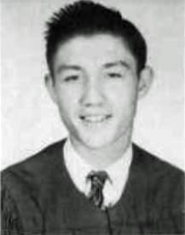
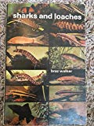
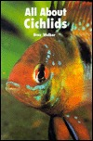
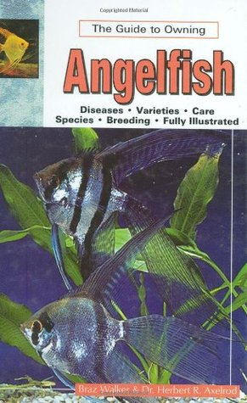
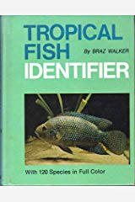
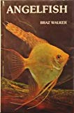
Braz Walker (1934 -1982)
Accomplished hobbyist James Brazelton Walker.
Paralized from the neck down after a diving accident at Texas A&M where he attended as a student.
He published articles in a number of club publications, science journals and aquarium magazines, as well as several books.
Did his writing and photography while in an iron lung.
Shortly after his death, FOTAS created the Braz Walker Endowment Program in Aquarium Science in his honor.

Slide 27
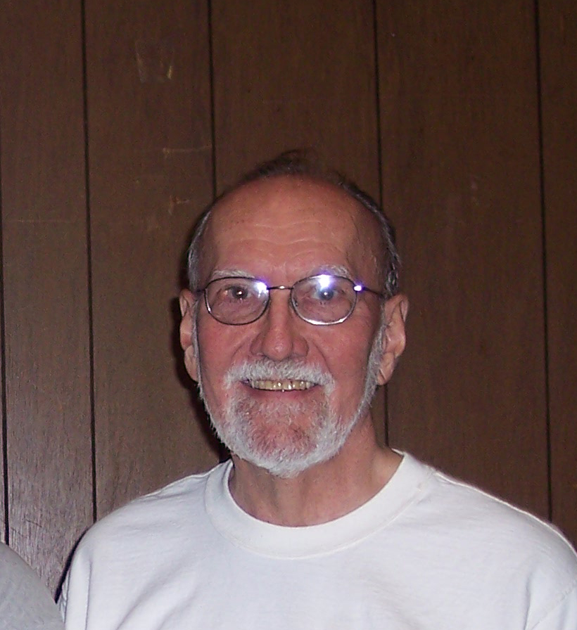
Dr. Keith Arnold
Dr. Keith Arnold FOTAS Patron. The award is to be presented annually to a person or persons that have contributed in an exemplary fashion to one or more FOTAS clubs financially or otherwise
Long time member of the Brazos Valley Aquarium Society in 1972.
Dr. Arnold began his tenure at Texas A&M University in 1966 as assistant Professor in the Department of Wildlife Scinece.
Half of his time was spent at the Texas Experimental Agricultural Station.
Dr. Arnold became an associate professor in 1973 and full professor in 1979.
He taught and carried out bird research for 39 years.
He retired in 2005 but returned to part time teaching until suffering a heart attack in 2006.
Well published in aquarium outlets. Other publications have been in scientific or bird journals.
Dr. Arnold wrote and then published the renown and beautiful Birds of Texas in 2007
Dr. Arnold was the life blood of FOTAS For several decades serving as treasurer most of his tenure.

Slide 28
Marvin England
Marvin served as an officer and board member of the American Cichlid Association, The Texas Cichlid Association and the Federation of Texas Aquarium Societies.
Marvin has promoted the hobby where ever possible and is a fixture of the Texas Aquatics scene.
Marvin has had a tenure as FOTAS President and serves on numerous committees, and along with Dr. Arnold, serves as FOTAS advisor.
Marvin is an accredited show judge and is a member of the Fish Judges Registery.
Living in Texarkana, Marvin and Kathy make extended road trips to most regional functions.
The Marvin England award was created to recognize those people that drive long distances to attend FOTAS shows.

Slide 29
FOTAS Education Awards
Award is presented to a student who’s studies have implications in aquatics.
This a generally a $500.00 bursary usually awarded once annually.
This was established in 2000 and $7500.00 has been awarded to date.
The Braz Walker and Dr Keith Arnold funds go directly to supporting the education award.
Previous recipients include Dr. Hernan Lopez-Fernandez.

Slide 30
FOTAS FACTS
Charter Clubs – Aquatic Researchers of San Antonio
Houston Aquarium Society
Oklahoma City Aquarium Society
Dallas Aquarium Society *** (possibly, not confirmed)

Slide 32
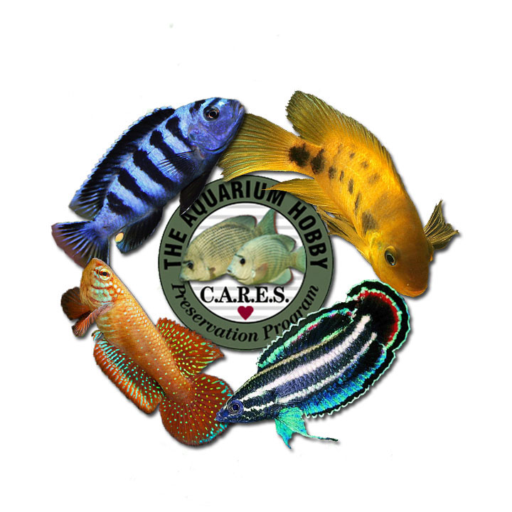
FOTAS Conservation
FOTAS has reconized that aquatic conservation measures should be a major focus.
We have aligned ourselves with CARES hosting the first CARES convention, named FOTAS CARES, in 2011.
FOTAS maintains an independent CARES program open to members of all FOTAS clubs.
FOTAS promotes CARES by awarding other aquarium clubs (not only FOTAS affiliates) the FOTAS CARES medal of honor for “Best CARES Fish in Show”.

Slide 33
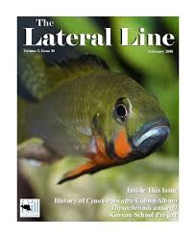
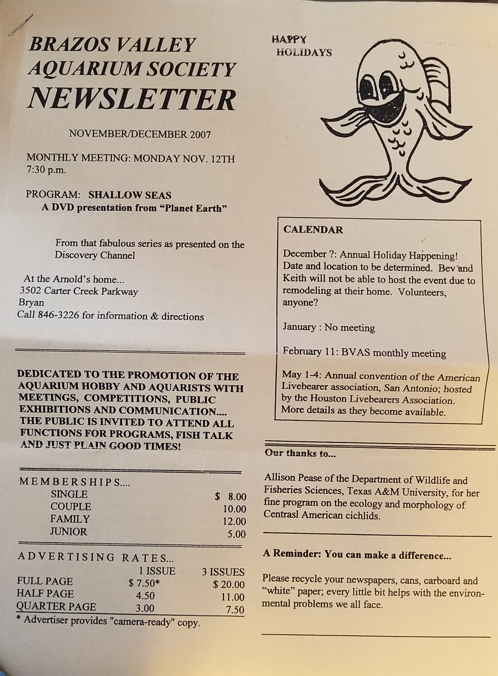
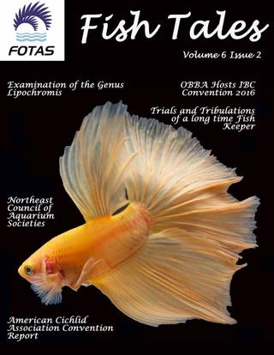
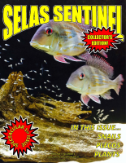
FOTAS Publications

